Slide 1
IoT – From sensor to app

Slide 2
Structure
Task and given Scenario
Solution Architecture
OPC UA and MQTT
Hardware and sensors
Flatter App
Influx

Slide 3
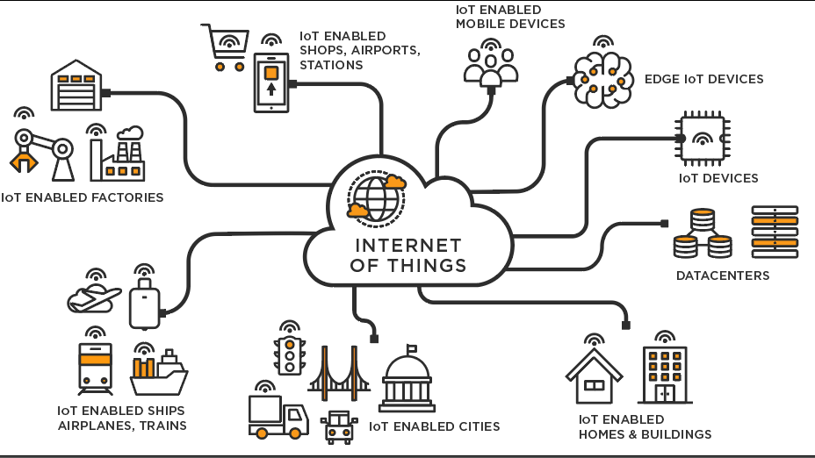
Task
Internet of Things (IoT) is a fundamental prerequisite for Industry 4.0
It enables cross-network communication of all sorts of “things”
An important aspect here is the communication of sensor data
Sensor data is important for the control of industrial processes

Slide 4
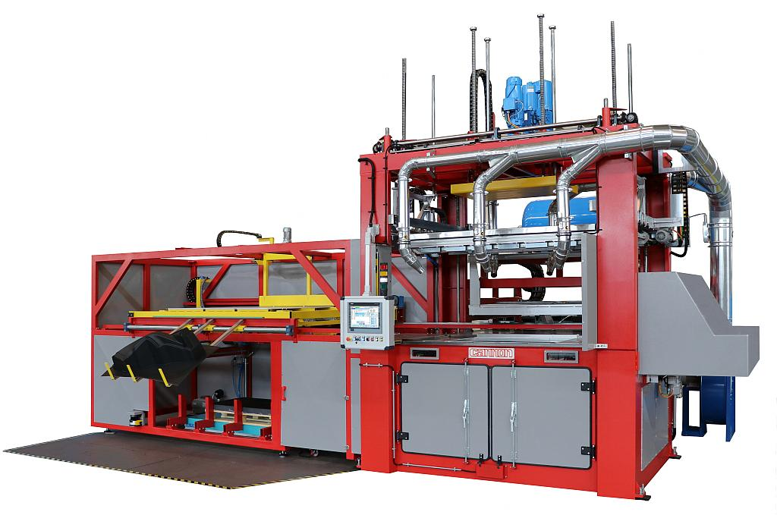
Scenario
Question: How can I capture sensor data to send it to a server for visualization or further processing?
Example: Deep-drawing machine
Goal: Read out three process temperatures
Oil temperature
Heat temperature
Return heat temperature
to transmit them by means of a network

Slide 5








Solution Architecture
Client 1 (Raspberry Pi)
OPC UA
MQTT
Temperature Sensor 1
Flutter App
OPC UA
Temperature Sensor 2
Client 2 (Raspberry Pi)
Server (Raspberry Pi)
OPC UA Server
MQTT Broker
Influx DB
OPC UA
Web Client
Hardware Button
Temperature Sensor 3
Client 3 (Raspberry Pi)
Client PC
Dashboard
Matrix dot display

Slide 6

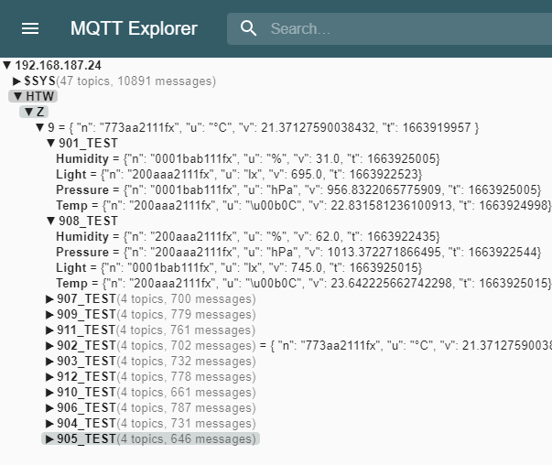
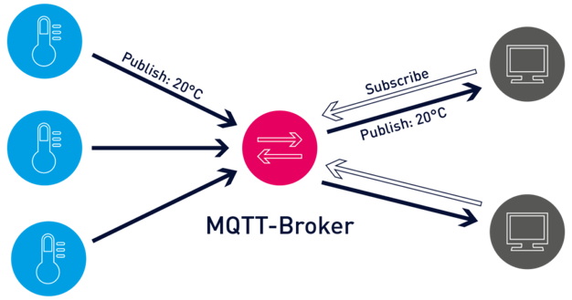
MQTT - open network protocol for machine-to-machine communication

Slide 7

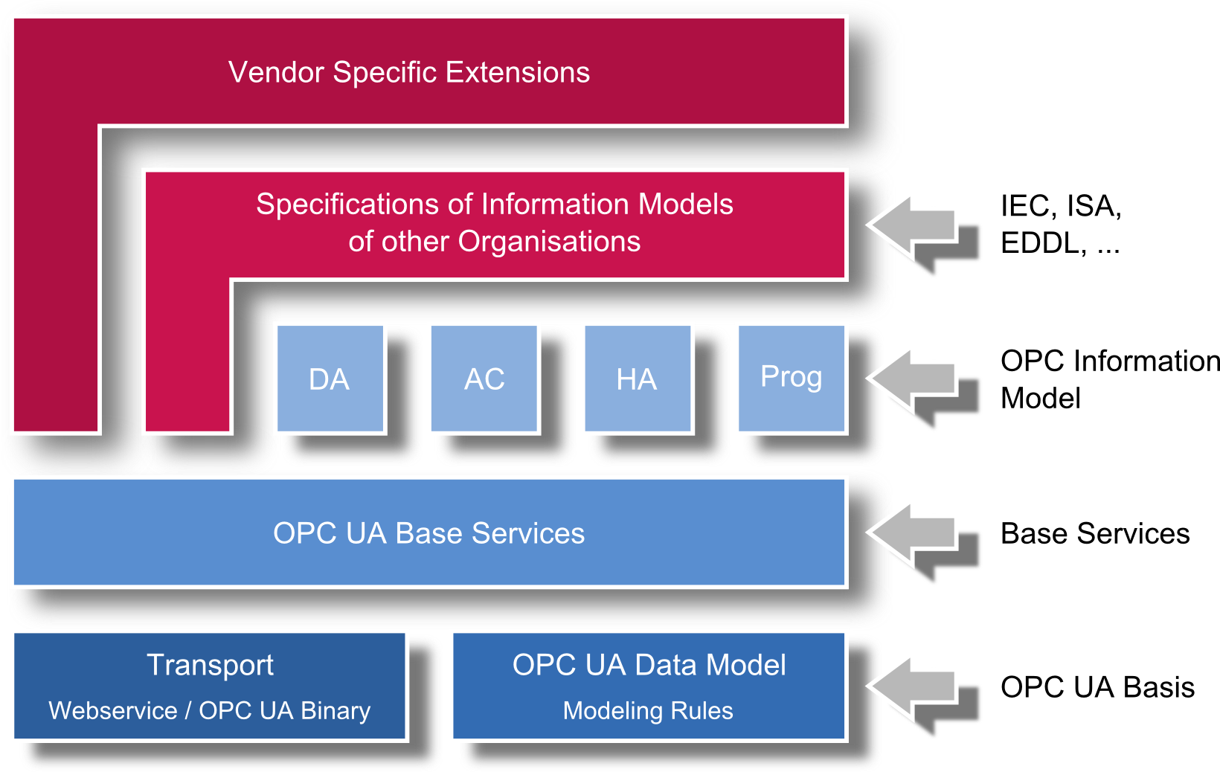
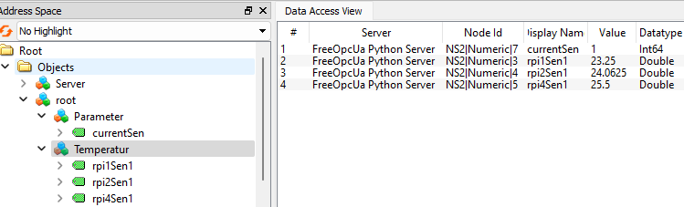
OPC UA - Extensible and platform-independent standard for platform-independent data exchange usually for industrial applications

Slide 8
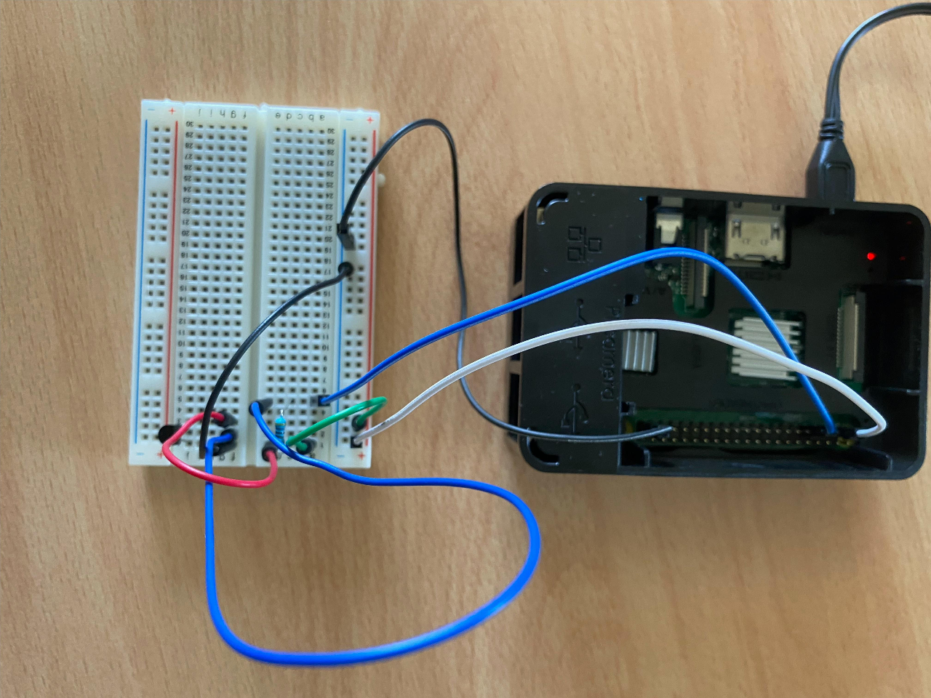
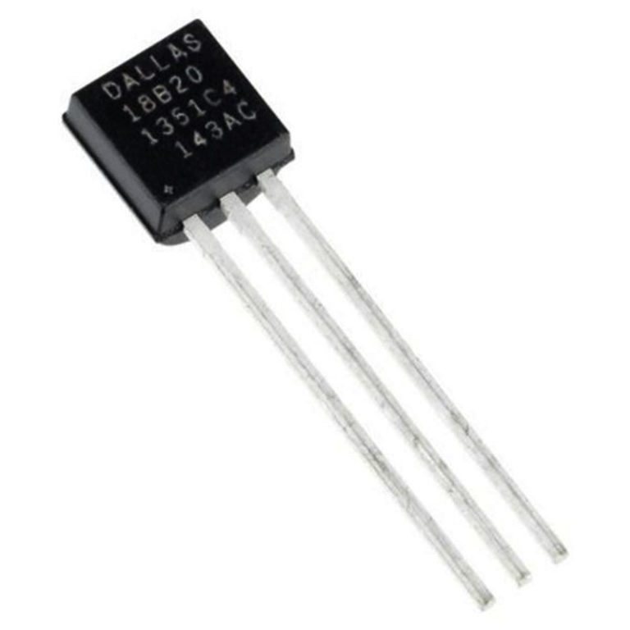
Hardware and Sensors
Raspberry Pi serves as an IOT-Device connected over Wifi Netzwerk
DS28B20 – digital temperature sensor with one wire protocol

Slide 9
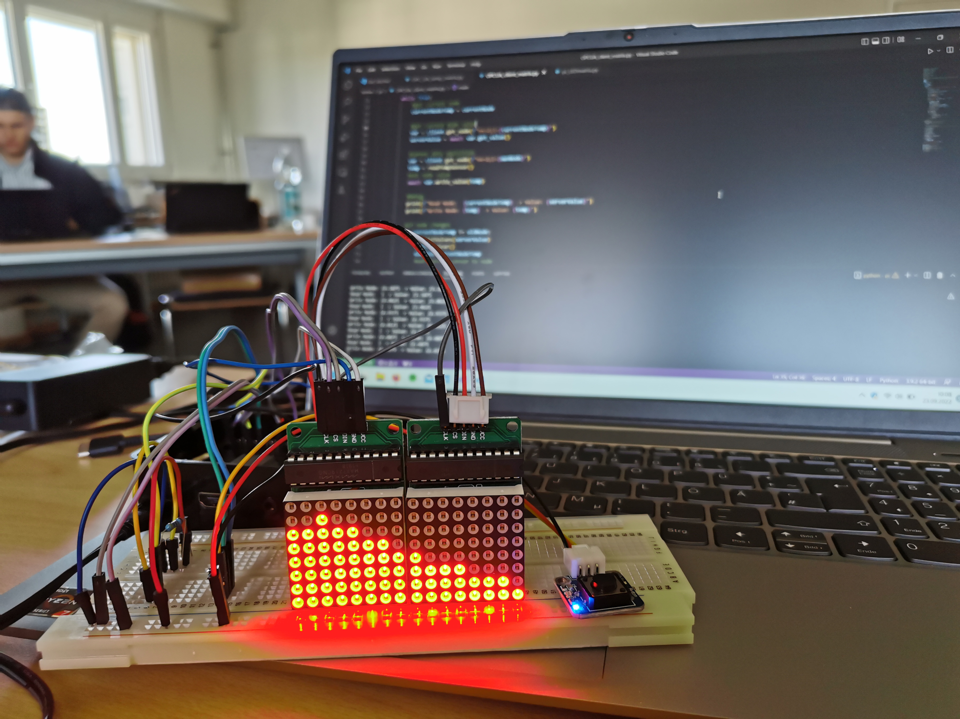
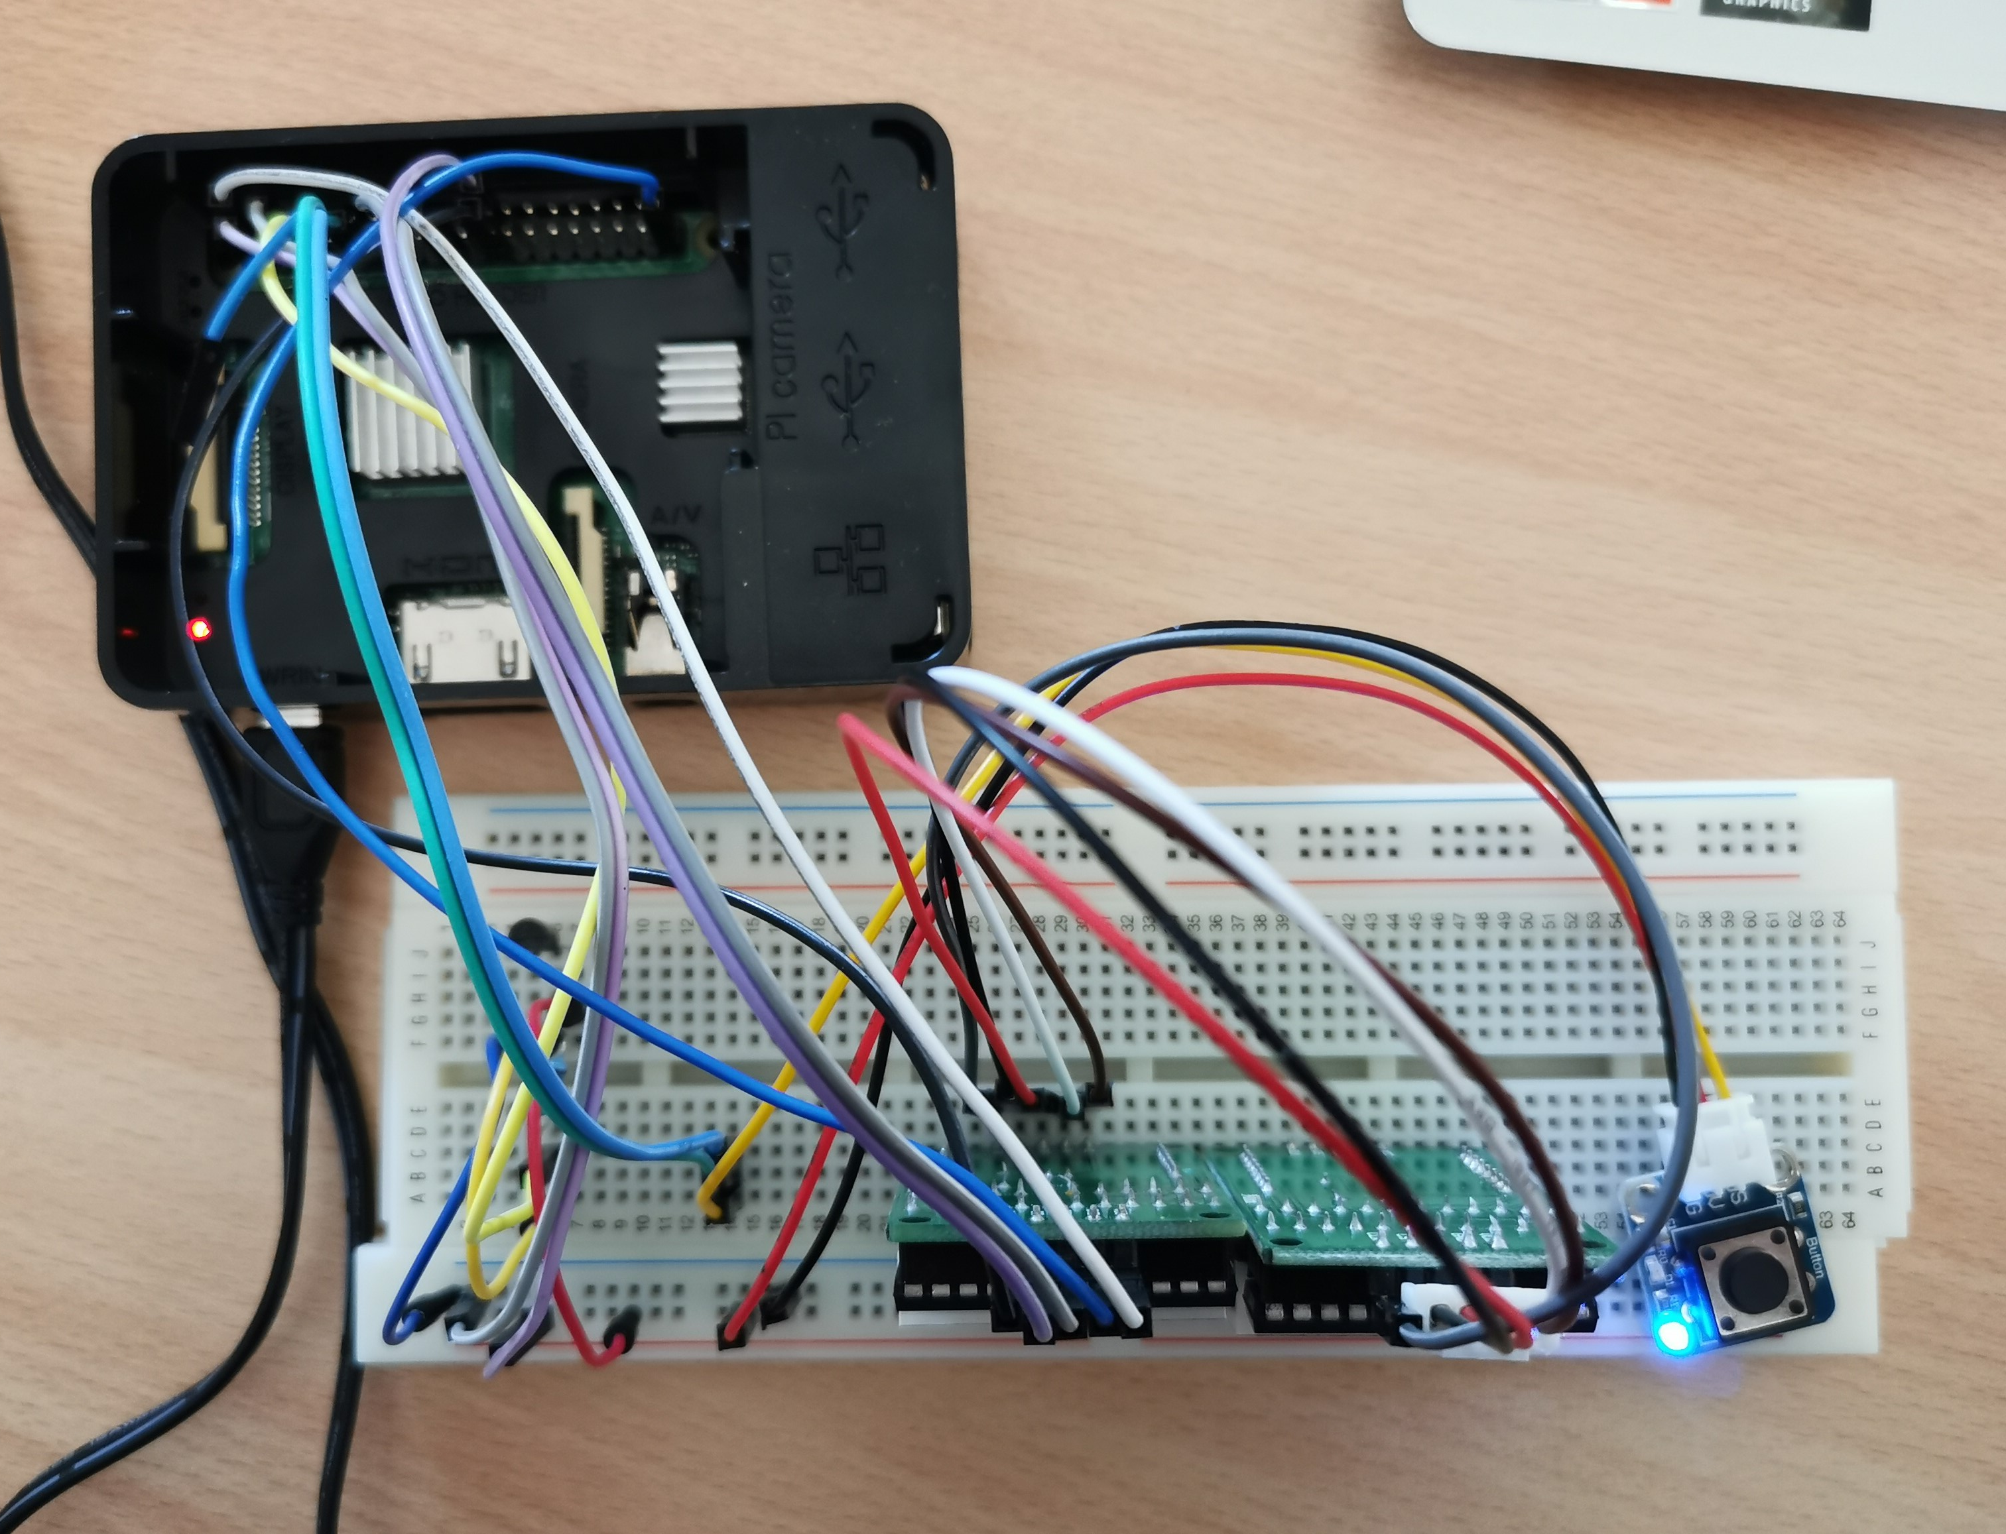
Matrix Display "MAX7219 Dot Matrix"
Top Down View
Raspberry pi
Temp Sensor
Matrix display
Button

Slide 10
Program cycle
Client with sensor and display
Client with sensor
Init client and connect to OPC-UA server
Read sensor value
Push value to server
Pull selected data from server
Visualize values over time
Init client and connect to OPC-UA server
Read sensor value
Push value to server

Slide 11
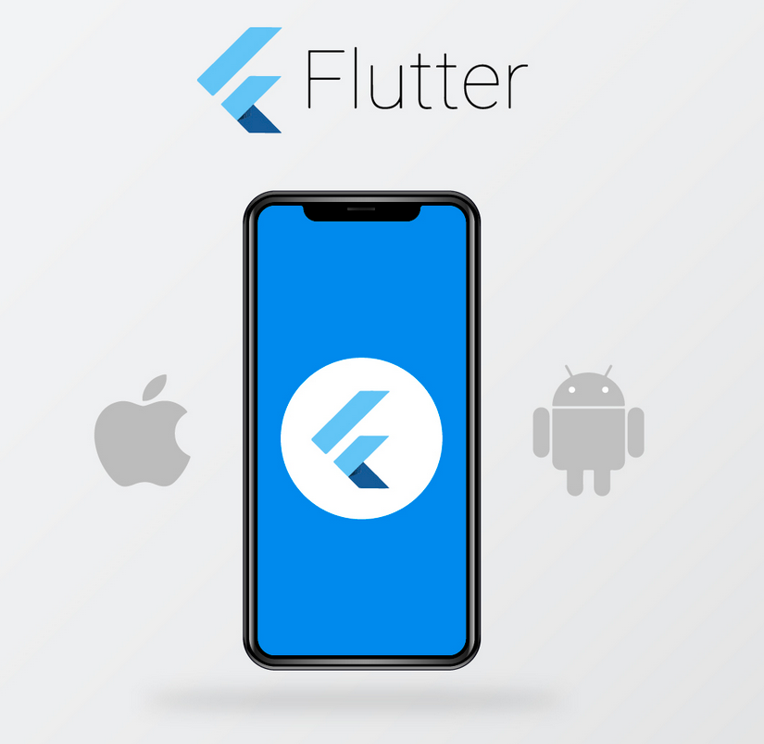
Flutter App
Open-source UI software development kit for cross-plattform applications
Created and maintained by Google (2015)
„Dart“ programming language for object-oriented creation of „widgets“
one single codebase
Android
iOS
MacOS
Linux Windows
web

Slide 12
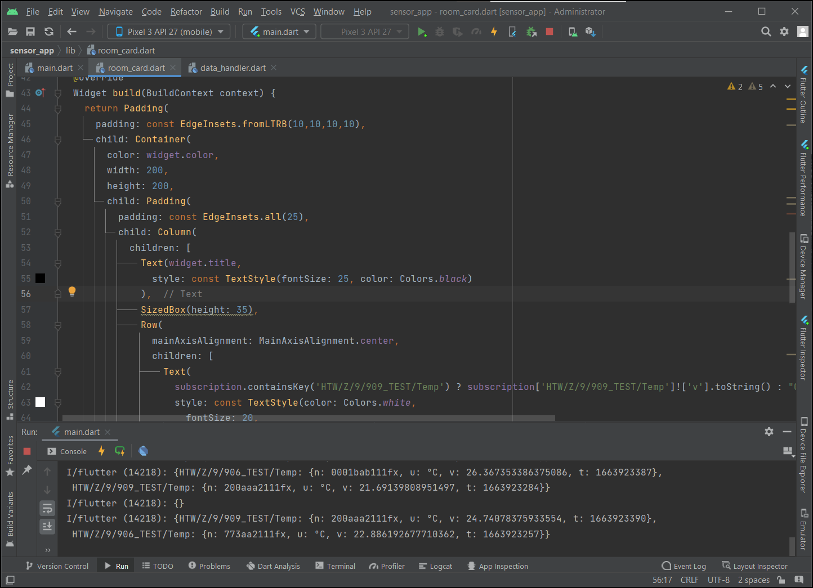
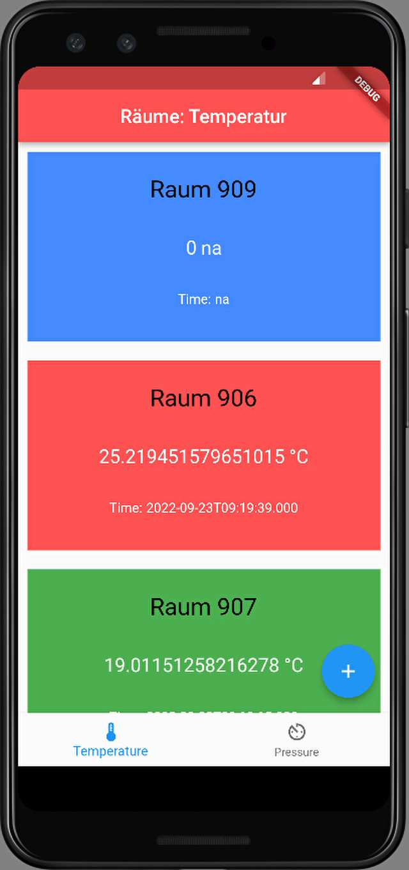

Flutter App
Android Studio paired with emulator for target platform (here: Android Emulator)

Slide 13
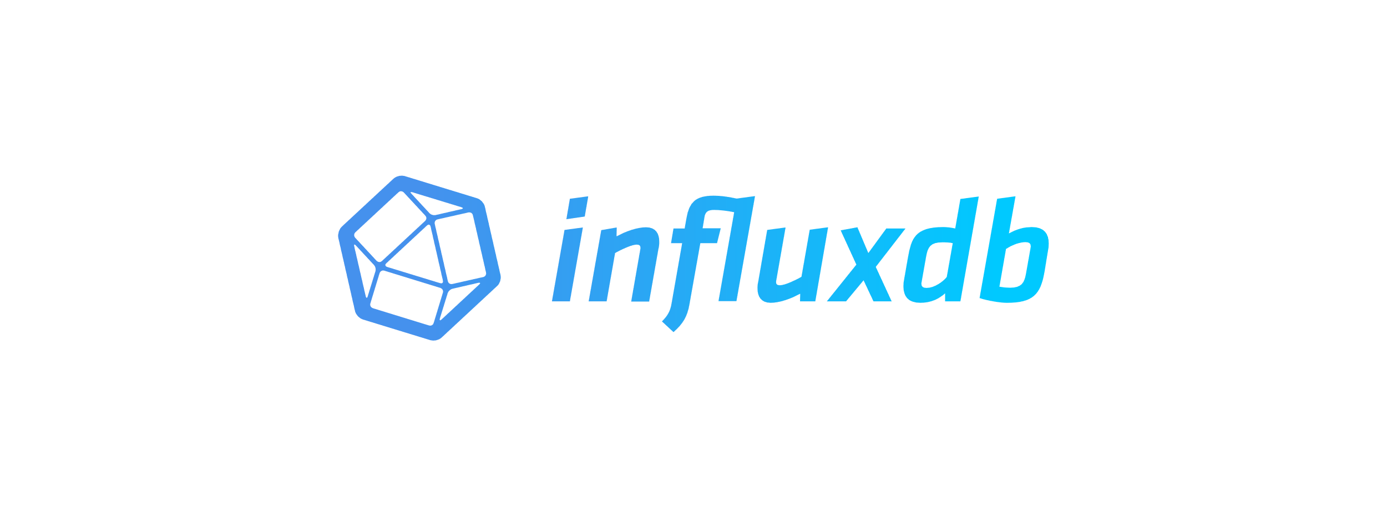
Influx DB
Web Client
Server (Raspberry Pi)
MQTT Broker
OPC UA Server
Influx DB
Client PC
Dashboard
Telegraf
Notes:
- Open Source Datenbankmanagementsystem Firma Influx
- Influx Server auf Raspberry Pi
- Übertragung von OPC UA Server in Influx DB Server über Telegraf
--> Plugin für OPC UA

Slide 14
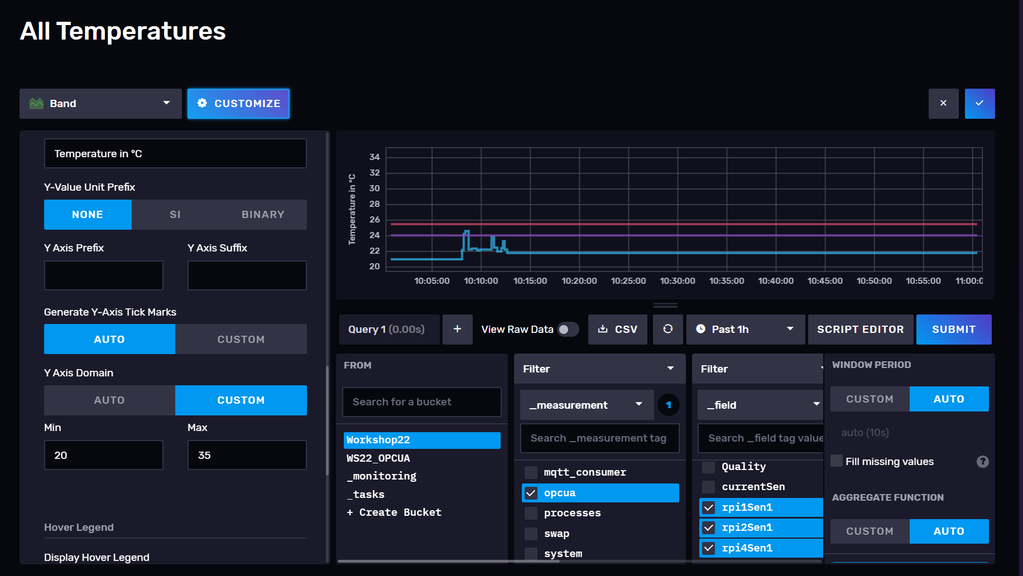
Influx DB
Configuration with interface
Notes:
- Zugriff auf Influx Server über Browser möglich
- Konfiguration kann über Interface erfolgen:
- Auswahl des Darstellungstyps
- Auswahl Datenquelle
- Anpassen der Darstellung (Achsen,

Slide 15
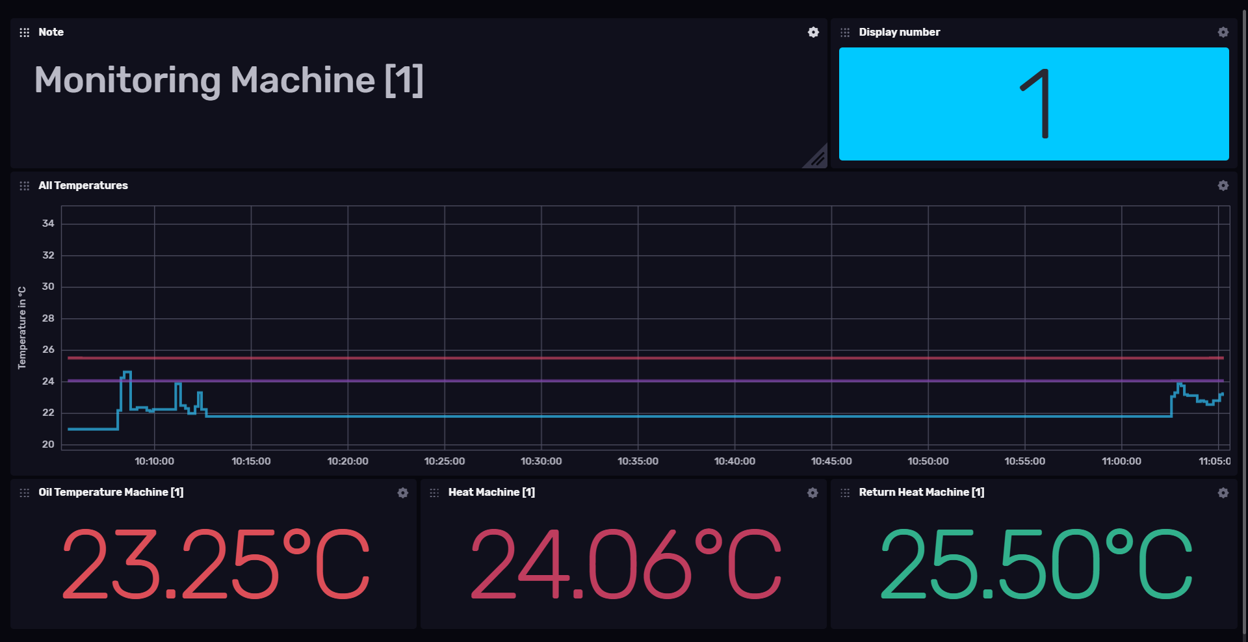
Influx DB
Finished Dashboard
Notes:
- Übersicht Prozesstemperaturen einer Maschine
- Graph mit Gesamtübersicht
- Einzelansicht verschiedener Temperaturen
- Farbliche Markierung nach def. Bereich
Grün --> Normalbereich
Rot --> Temperatur weicht ab

